Slide 1
Large Scale Mining
Does not Pass the Test on all Value Chain Criteria
Maita Gomez
Bantay Kita
University of Sto. Tomas
February 28, 2012

Slide 2
Rights – Based Approach
As CSOs we employ a rights based approach to governance and development objectives
We recognize our rights to freedom, to have access to the basic means to live dignified lives, to good governance, to a better and more secure future for our families & future generations
This is what we mean when we say that we want to achieve sustainable development

Slide 3
Stakeholders Have Different Concepts of Development
The private sector wants more and better business opportunities
The government often proclaims that it is for sustainable development but its priorities are often defined by those with political influence
CIVIL SOCIETY wants
  Better governance
  Greater participation in decision-making.
  Sustainable solutions to our development problems

Slide 4
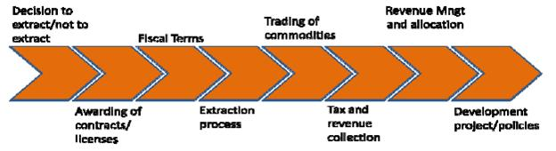
The Value Chain: Decision to Extract/Not to Extract
Notes:
Not comprehensive, Ask for inputs

Slide 5
Government Policy – defined by RA 7942 and EO 270 & 270-A
The exploitation of mineral resources is a source of economic growth/”development”
Our rich mineral resources are underutilized
Encourage investments and promote large-scale mining
Mining Law promotes responsible mining and sustainable development
PROBLEM: THAT IS NOT OUR EXPERIENCE!

Slide 6
Our Experience with Mining Policy
The Law is biased in favor of big business
Development objectives (improved livelihoods and environmental safeguards) are not met
Oppression, human rights violations, dispossession and displacement

Slide 7
Awarding of Contracts

Slide 8
The Fruits of Engineered “Consent”
Companies - do not always negotiate in good faith
- Use resources to buy support and “consent”
- Cause social division
- Violate human rights
- Cause environmental hazards
Government - regulation “captured” or inadequate

Slide 9
The Fruits of Engineered “Consent”
RESULT: INCREASED OPPOSITION TO MINING!
Over 20 LGUs have passed resolutions restricting mining
National and local governments stand on opposing sides of the issue

Slide 10
Awarding of Contracts

Slide 11
All Mining & Quarrying Activities are Subject to a 2% Excise Tax

Slide 12
But large-scale Mining Favored with Additional Incentives
SOME EXAMPLES
No tax during exploration period
5 YEAR Income tax holiday
No tax for importation of machinery, equipment and materials, for pollution control devices
Tax deductions for labor and all other expenses including taxes incurred up to the first 5 years of operations
Total government share in MPSA is 2% excise tax on value of production

Slide 13
Incentives can be Unnecessary or Redundant
Analysis in a Study by UP Professor Renato Recide (2005)
Incentives are redundant/unnecessary if
- seeking a domestic market
- resource (labor, minerals, lumber) seeking

Slide 14
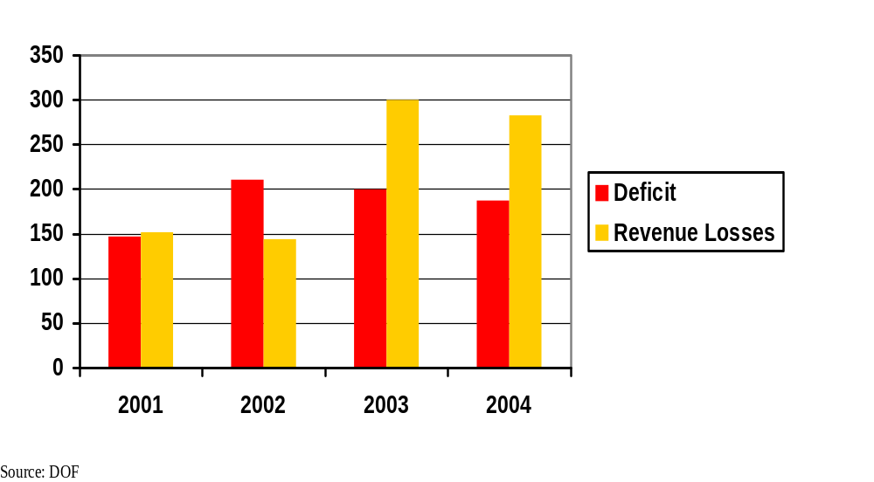
We cannot afford these incentives
Tax and Duty Exemptions under Various Fiscal Incentives Laws vs. Deficit (B PhP)
Notes:
“The estimated foregone revenues do not include the 5% preferential tax rate enjoyed by ecozone locators. It also does not include the other tax exemptions such as exemption from income tax or other taxes granted under special laws.”, Amount of Tax and Duty Exemptions Granted Under Various Fiscal Incentive Laws, DOF

Slide 15
Revenue Effort: Philippines vs Mining

Slide 16
Extraction Process

Slide 17
Open Pit Mining and Related Issues
Serious environmental destruction
Dispossession, loss of livelihoods
Downstream communities seriously affected
Timber, water & easement rights
Notes:
Ask respondents about issues on this

Slide 18
Trading of Commodities

Slide 19
Exports of Non-Metallic Minerals vs. Gross Production Value of Non-metallic Mining,
2000 -2009 (in B PhP)
Source: MGB

Slide 20
Exports of Minerals and Mineral Products and Gross Value of Metallic Mineral Production,
2000 -2009 (in B PhP)

Slide 21
Tax and Revenue Collection

Slide 22
Potential vs Actual Excise Tax Collection
Source: MGB, BIR

Slide 23
Revenue Allocation & Management

Slide 24
Who Benefits?
In 2000 to 2009, poverty incidence decreased in all industry sub-sectors but in mining, it rose from 35 percent to 49 percent
Destruction of the environment/no meaningful development in affected areas
Mining companies defend RA 7942 because they benefit. We do not.

Slide 25
Development Policy

Slide 26
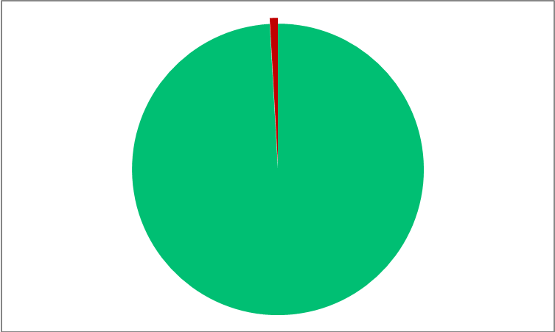
Average Contribution of the Mining Industry to Philippine GDP from 2000-2009
Mining & Quarrying 0.91 % of GDP
Highest in 2007 at 1.4%
Source: MGB

Slide 27
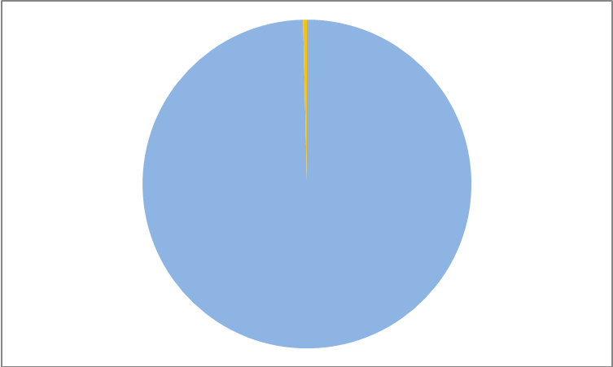

SHARE OF M&Q IN
EMPLOYMENT
(‘00 –’09)
On the average, the industry’s contribution to total employment during the decade was a mere 0.376 %.
Not necessarily due to large-scale mining
0.376 %
Source: MGB

Slide 28
Large –Scale – 22 operating mines (8 gold , 3 copper, 1 polymetallic, 1 chromite and 10 nickel mines) in operation. (2009)
Small-scale – MGB admits no accurate data, estimates about 300,000 operations throughout the country. Production sold to Bangko Sentral.
Non-metallic - number fluctuates but approximately 2500 since the beginning of the decade.
Source: MGB

Slide 29
Extraction for Export IS NOT SUSTAINABLE
Most of the production is exported, Only one copper smelting and one nickel processing plant in operation.
Most of the value is added after minerals leave the country
The Law does not make provisions for industrialization → Only insignificant & short term benefits
Minerals are depleted but no long-term benefits
WE NEED A MORATORIUM !
WE NEED A NEW & BETTER MINING LAW!

